Slide 1
THG Simulations
Project update
Week 5
??/08/2023
David Amorim

Slide 2
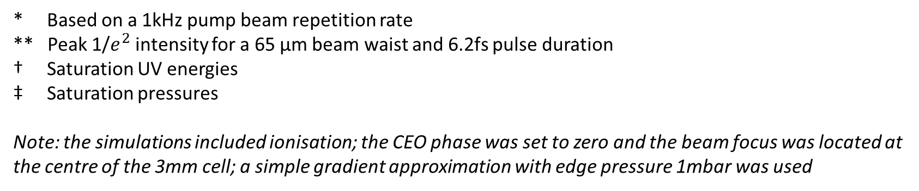
Relative Neon/Argon saturation values
Beam power* | Beam peak intensity** | E_Ne/E_Ar † | P_Ne/P_Ar ‡
75mW | 0.091 PW/cm^2 | 0.945 | 11.591
150mW | 0.182 PW/cm^2 | 2.302 | 11.588
200mW | 0.243 PW/cm^2 | 2.871 | 10.688
300mW | 0.365 PW/cm^2 | 3.376 | 10.143
* Based on a 1kHz pump beam repetition rate
** Peak 1/$e^{2}$ intensity for a 65 µm beam waist and 6.2fs pulse duration
† Saturation UV energies
‡ Saturation pressures
Note: the simulations included ionisation; the CEO phase was set to zero and the beam focus was located at the centre of the 3mm cell; a simple gradient approximation with edge pressure 1mbar was used

Slide 3
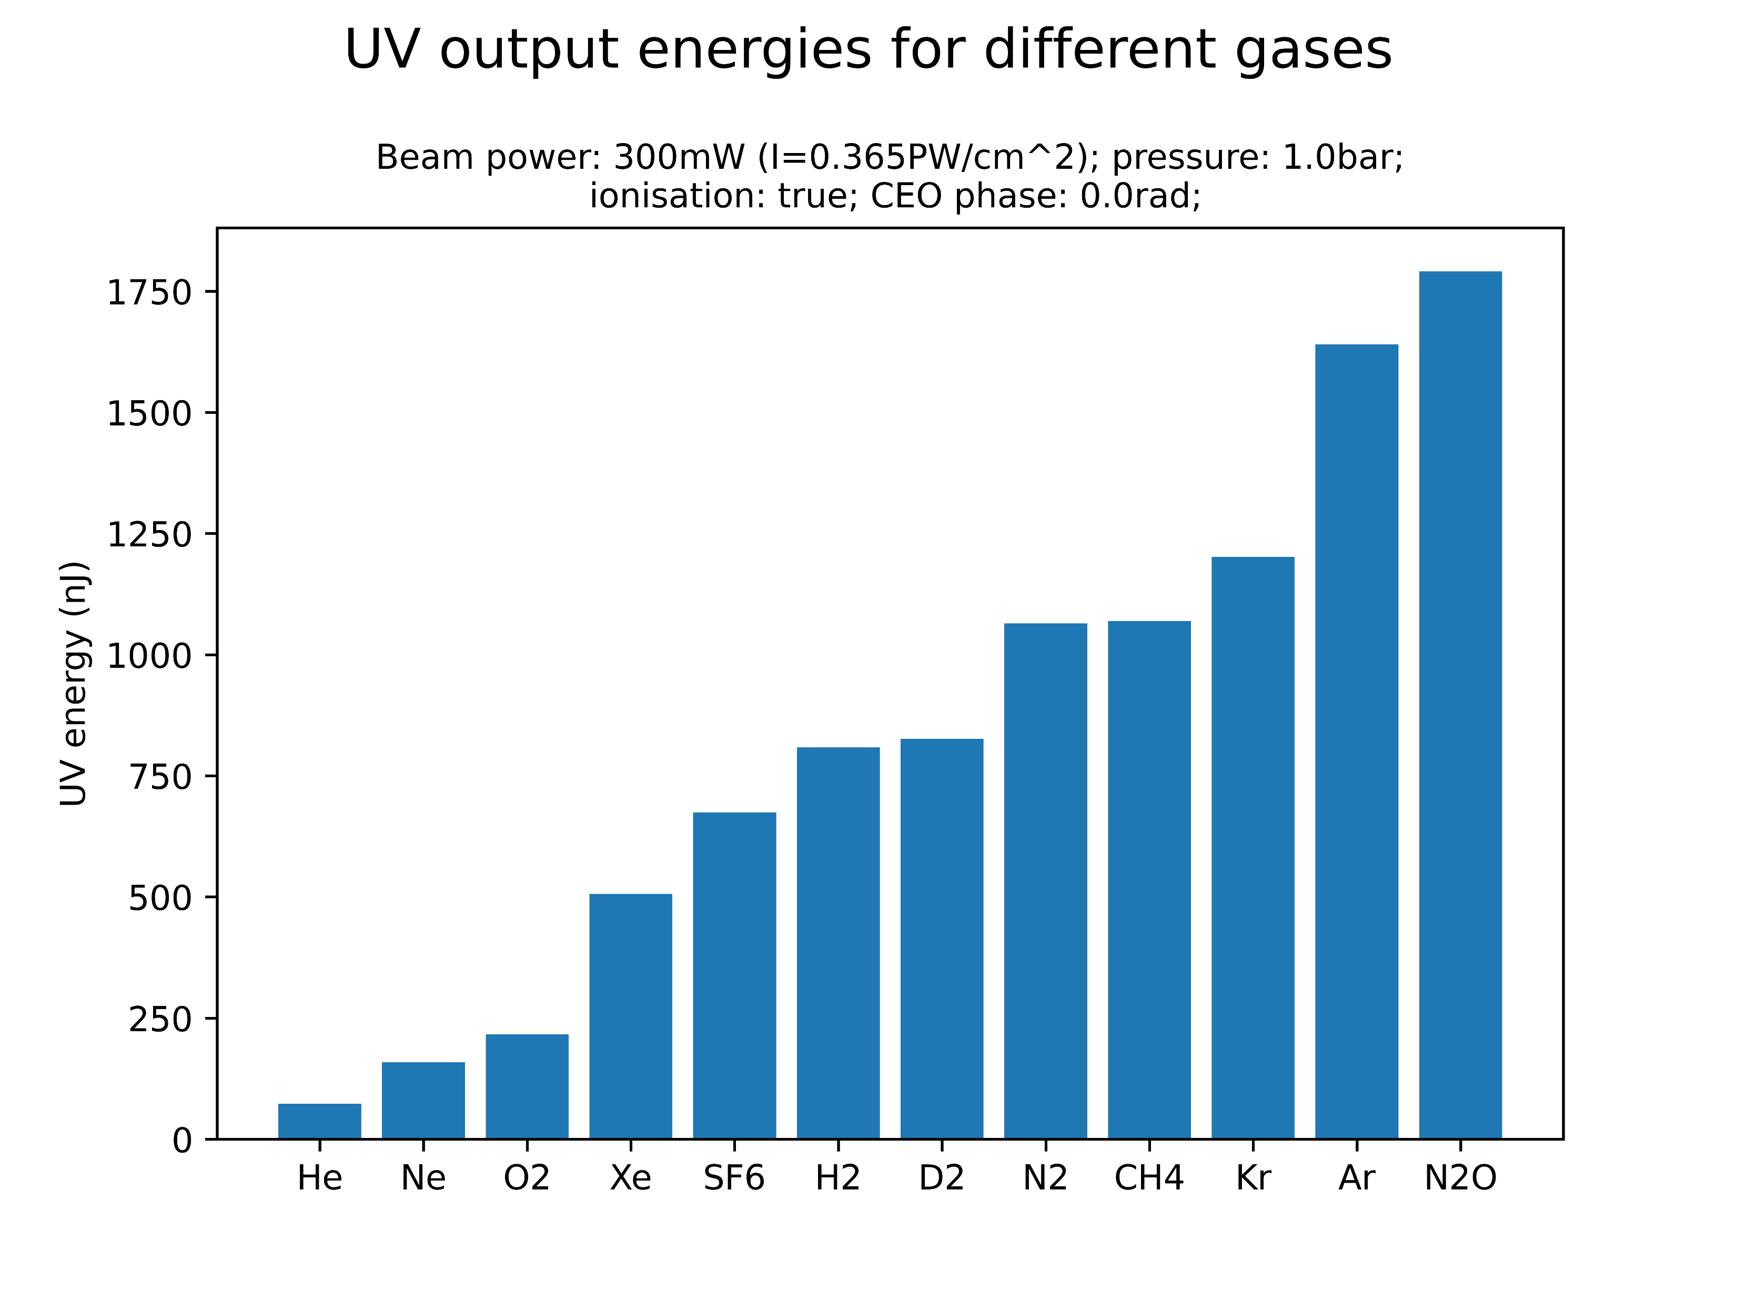
Comparison of different gases
At the given parameter values, the highest UV energies are generated by krypton, argon and nitrous oxide
Investigate Kr and N2O in more detail (plots on Sync&Share)?
Neon, on the other hand, yields the second-lowest UV energy
Note that relative gas performance is likely sensitive to central gas pressure and beam power: simulations should be extended!

Slide 4
Comparison of different gases

